Slide 1
I Future BD
Your Simple Choice for Electronics in Bangladesh

Slide 2




My Teammates,
Md Mehedi Hasan
Faiza Khandoker Fama
Jannatul Ferdous
21225103334
21225103338
21225103350
Abdullah Al Hill Baki
Mushfiqur Rahman Pulok
21225103341
21225103525

Slide 3
INTRODUCTION
“I Future BD" is a comprehensive e-commerce website designed for the online sale of electronic products. This project aims to provide users with a seamless shopping experience where they can browse a wide range of electronics, filter products by categories, add items to their cart, and make purchases through a simulated payment gateway. Additionally, it includes administrative functionalities to manage product listings and inventory.

Slide 4
Objective
01
User-Friendly Shopping Experience
02
Secure Transactions
03
Admin Control and Inventory Management
04
Automated Communication

Slide 5
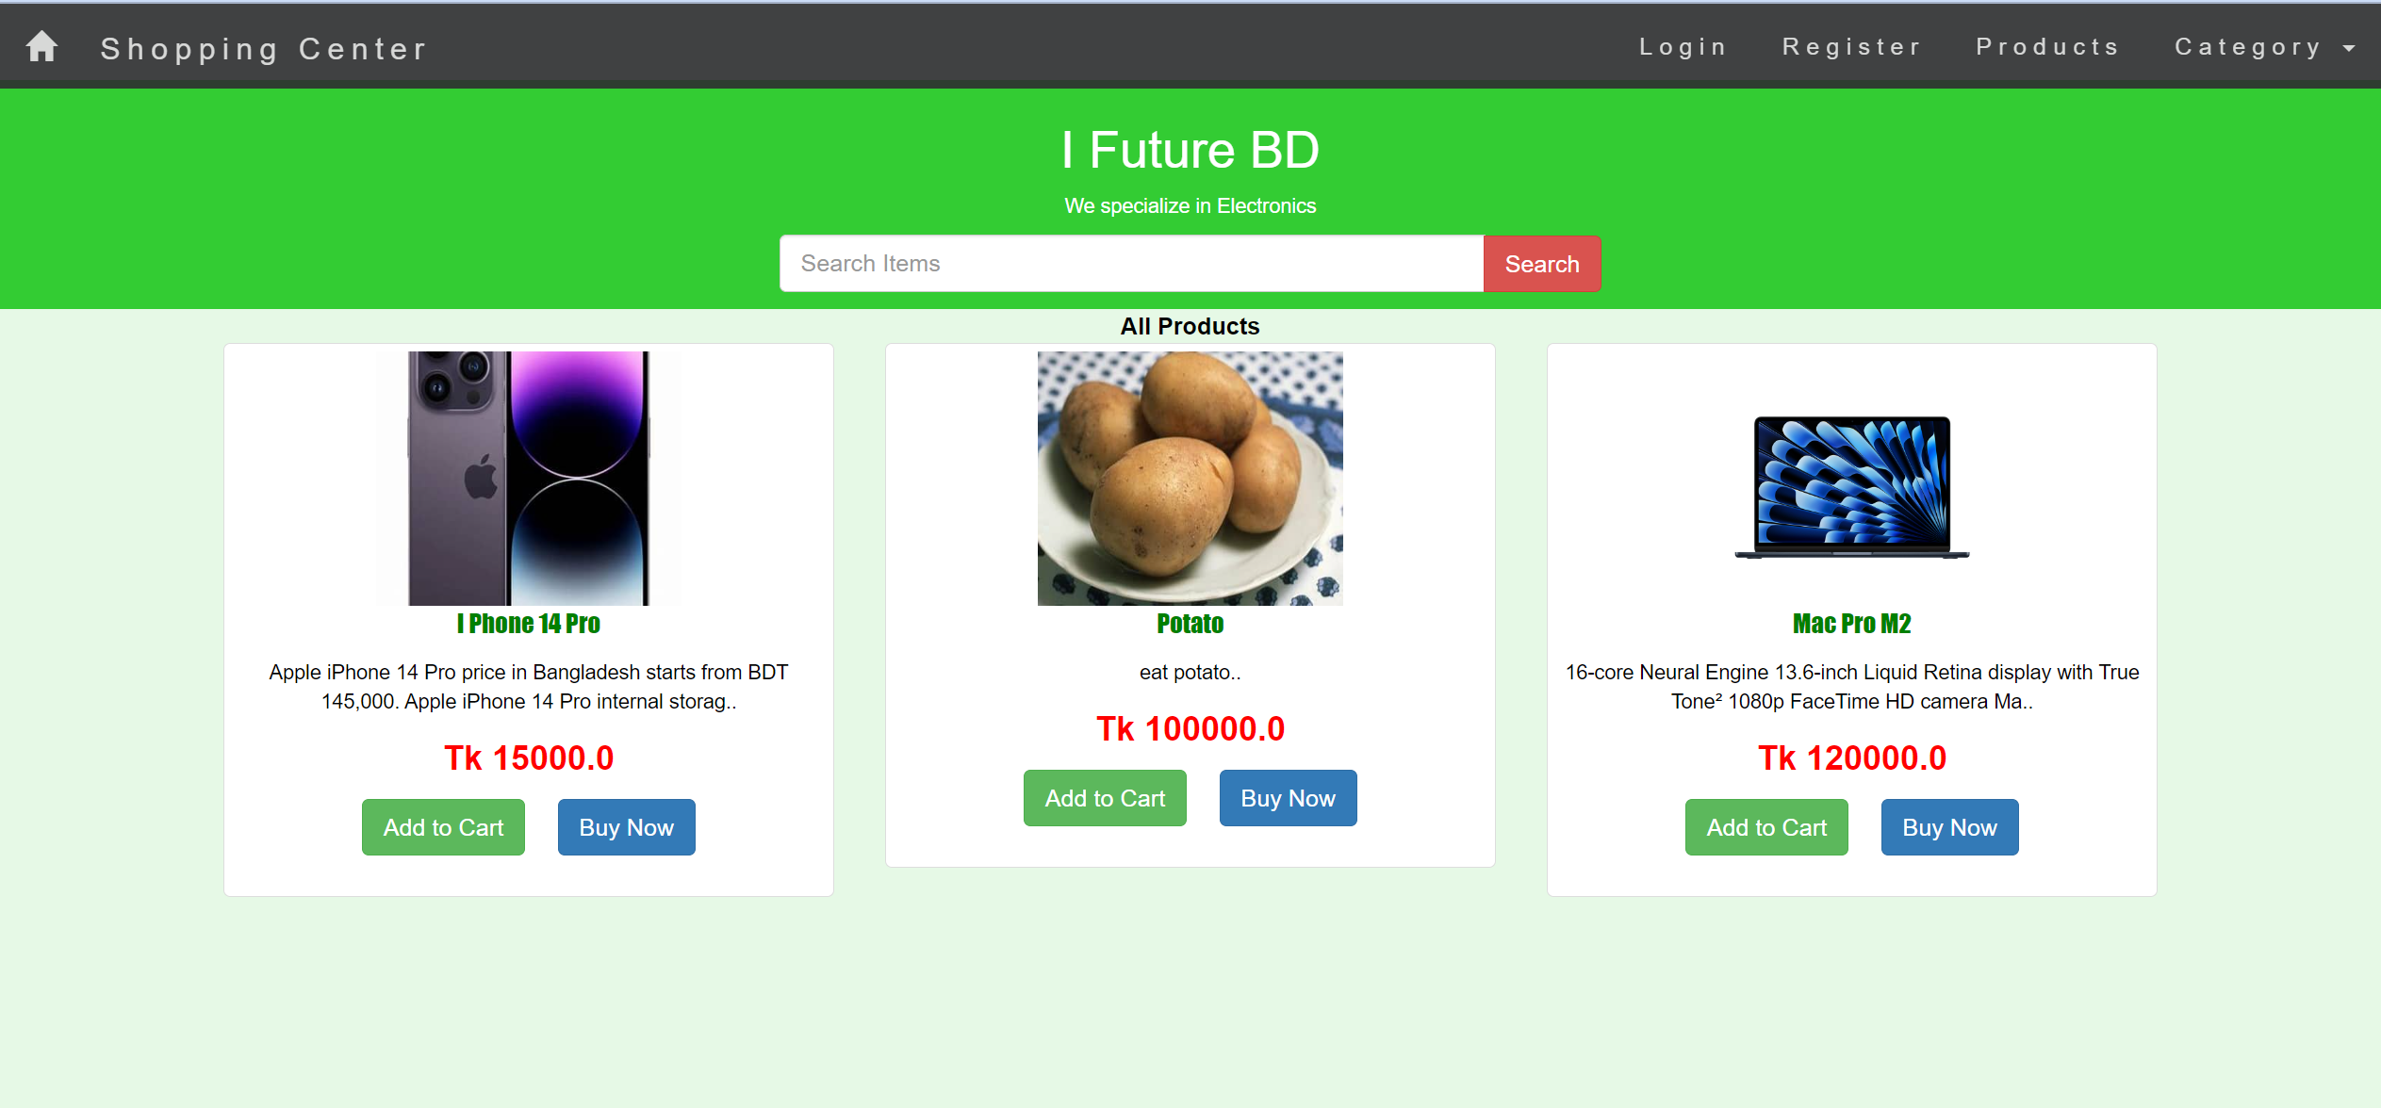
Class Name
LoginSrv.java
RegisterSrv.java
ProductBean.java
ProductService.java
ProductServiceImpl.java
AddtoCart.java
Home Page

Slide 6
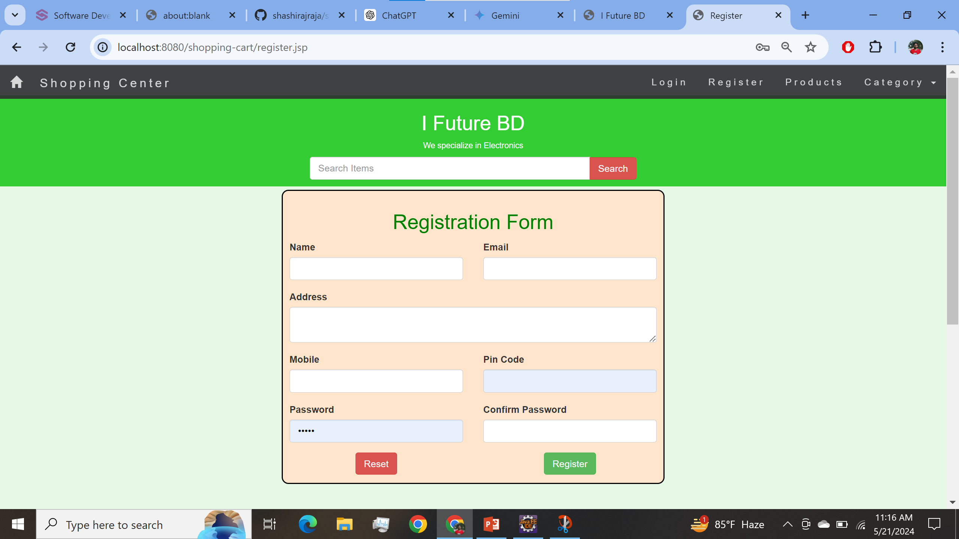
Class Name
RegisterSrv.java
JavaMailUtil.java
MailMessage.java
Registration Page

Slide 7
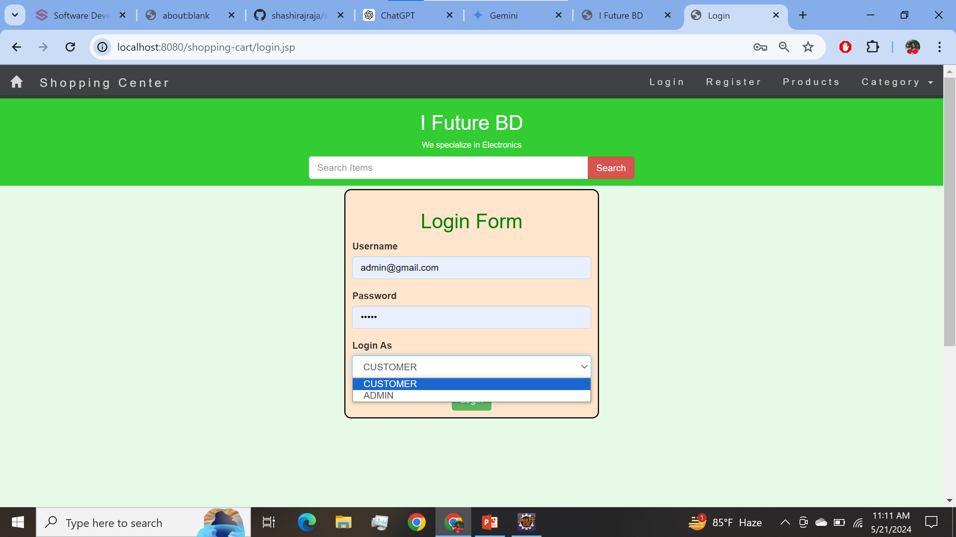
Class Name
LoginSrv.java
Login Page

Slide 8
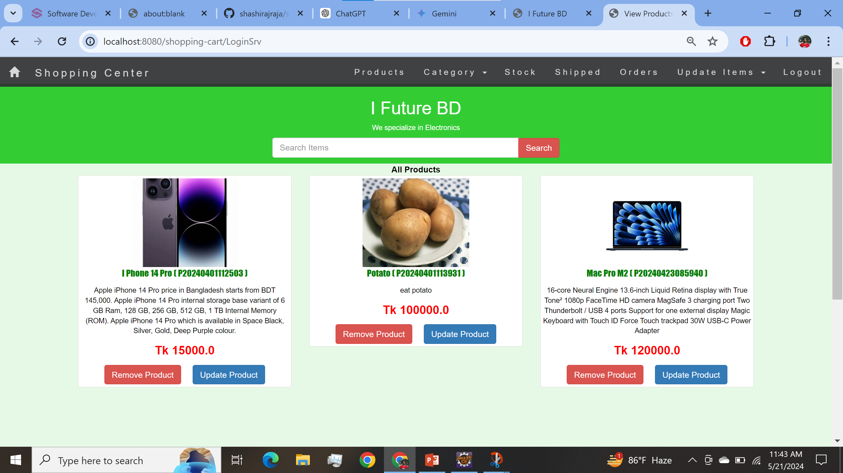
Class Name
RemoveProductSrv.java
UpdateProductSrv.java
ProductBean.java
ProductService.java
Admin home Page

Slide 9
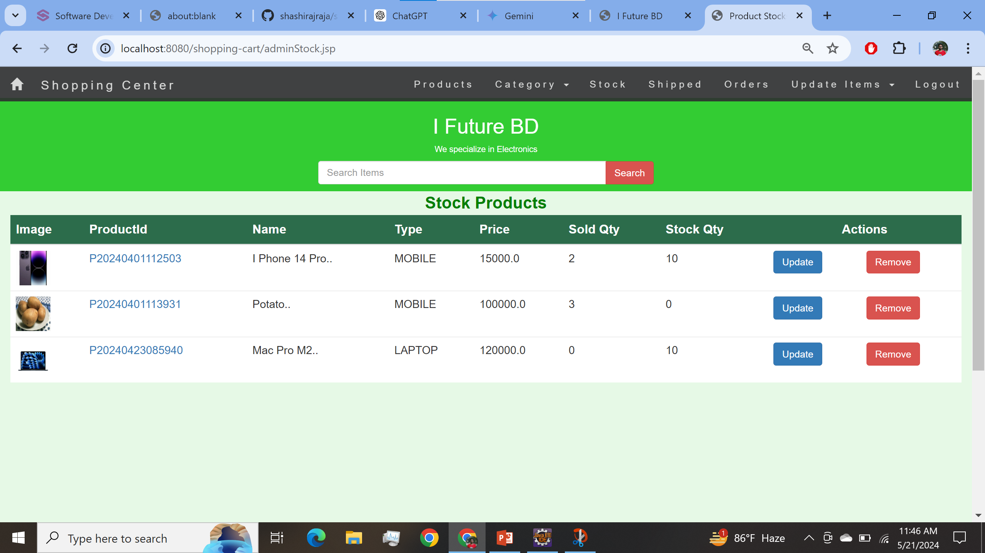
Class Name
DemandService.java
DemandServiceImpl.java
UpdateProductSrv.java
ProductBean.java
ProductService.java
Stock Page

Slide 10
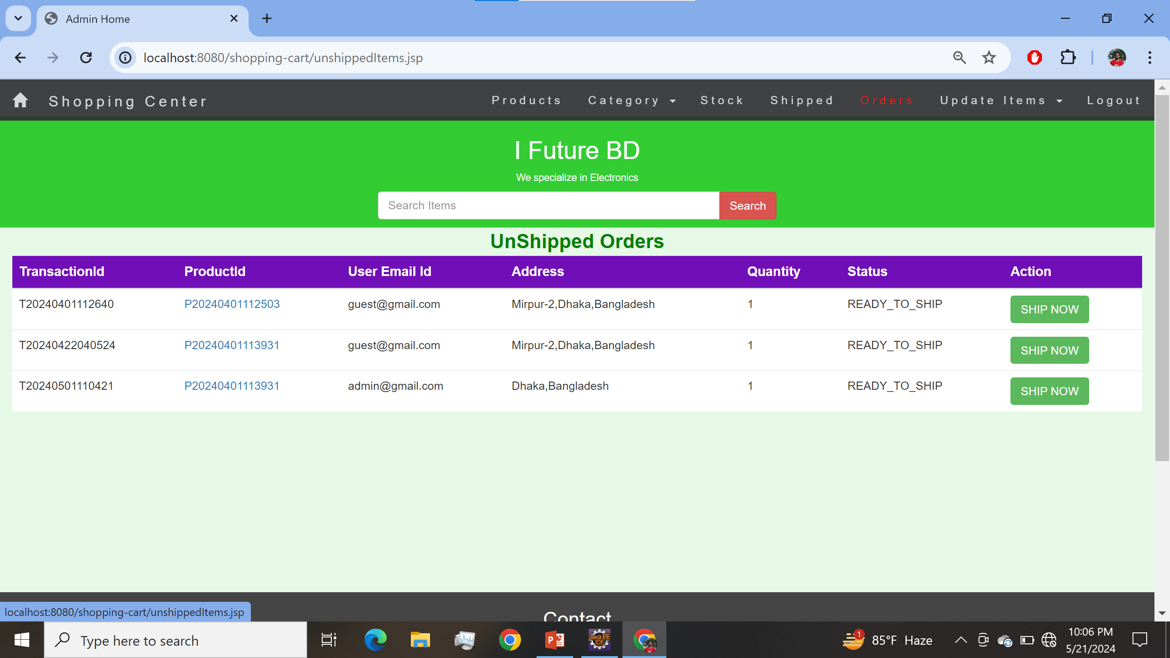
Class Name
ShipmentServlet.java
Shipped Page

Slide 11
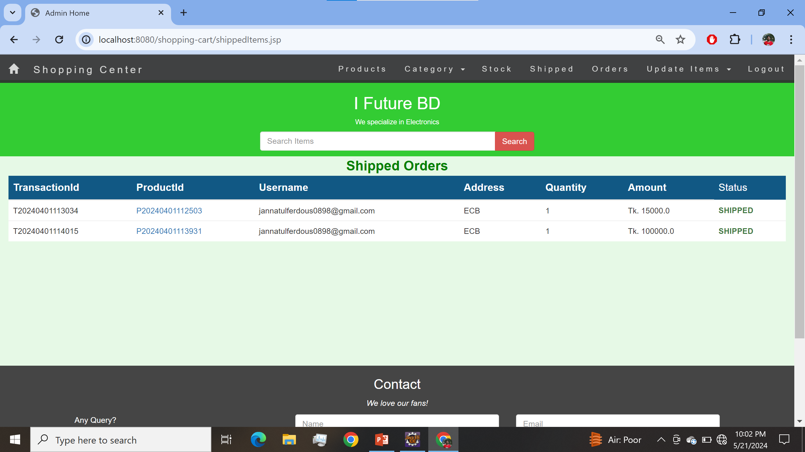
Class Name
ShipmentServlet.java
JavaMailUtil.java
MailMessage.java
Shipped Page

Slide 12
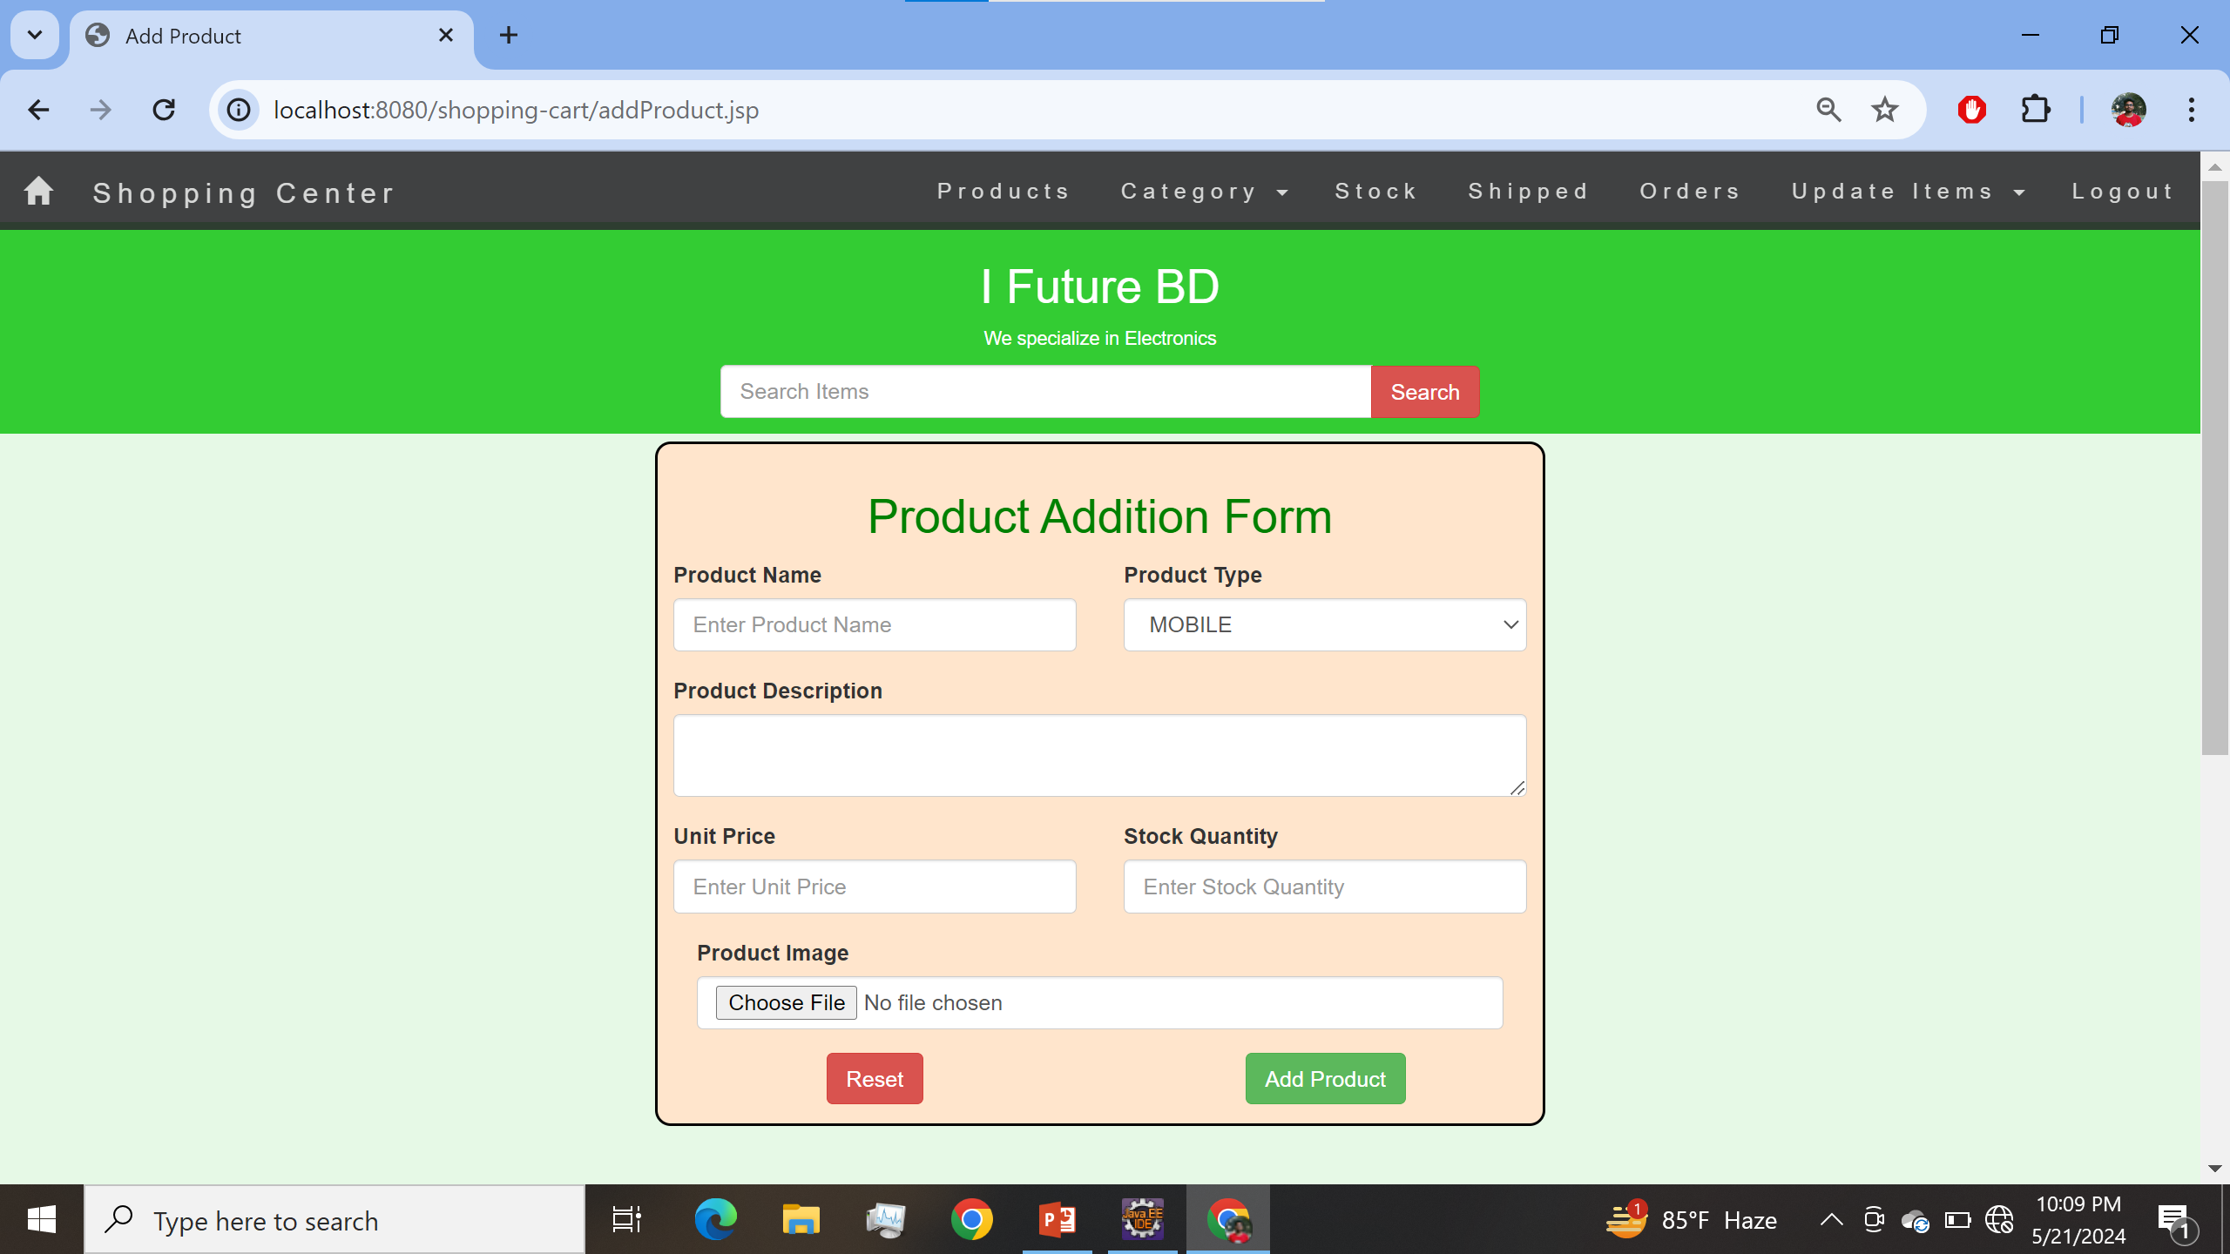
Class Name
AddProductSrv.java
Add Product Page

Slide 13
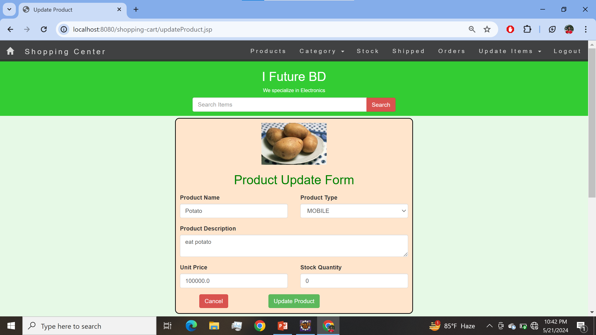
Class Name
UpdateProductSrv.java
UpdateProduct Page

Slide 14
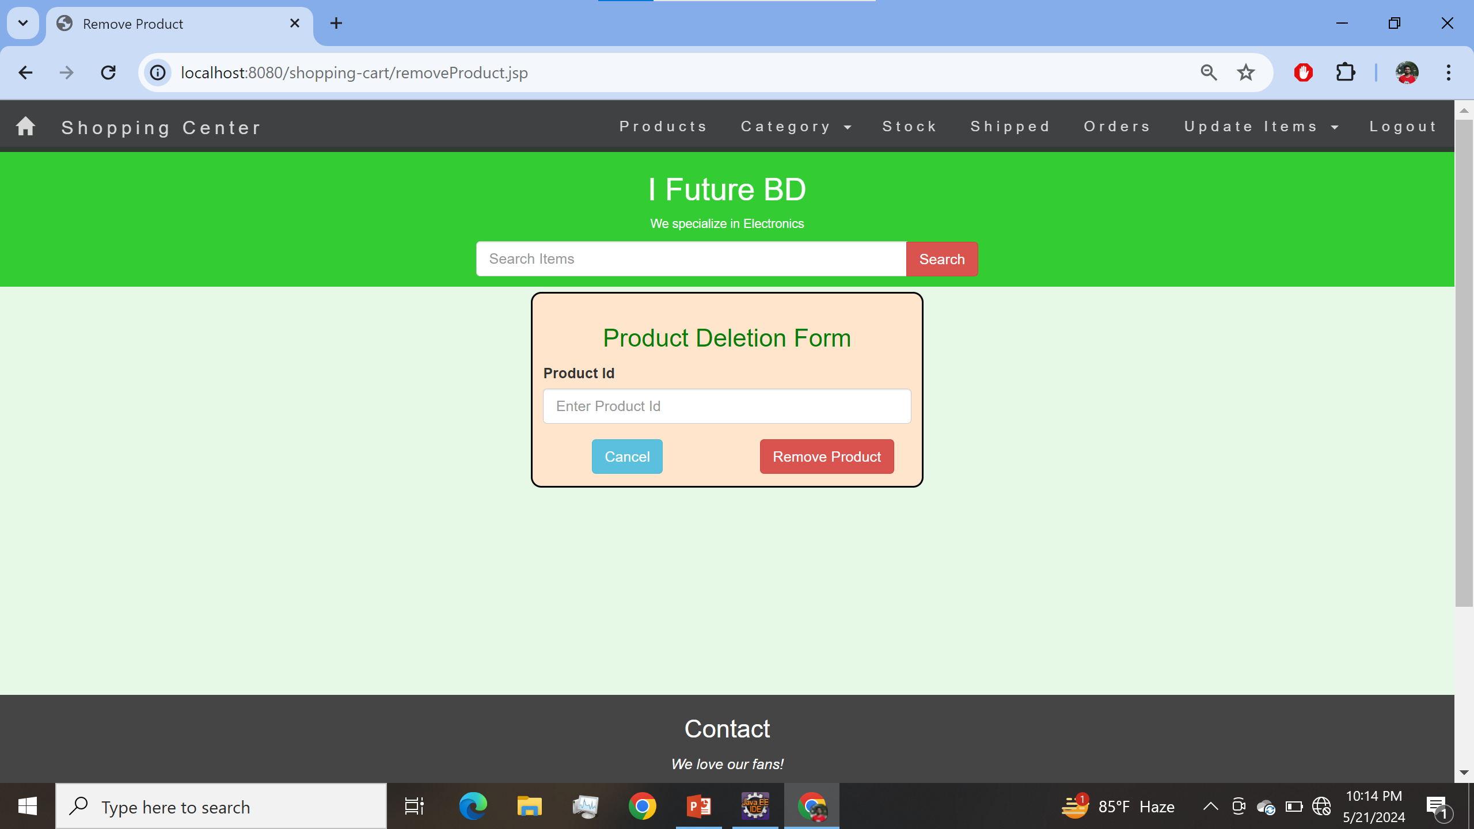
Class Name
RemoveProductSrv.java
Remove Product Page

Slide 15
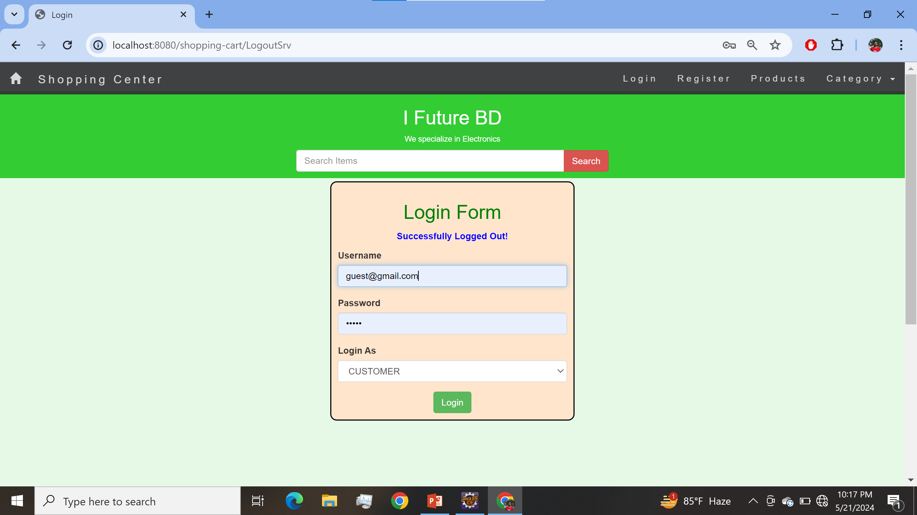
Class Name
LogoutSrv.java
Logout Page

Slide 16
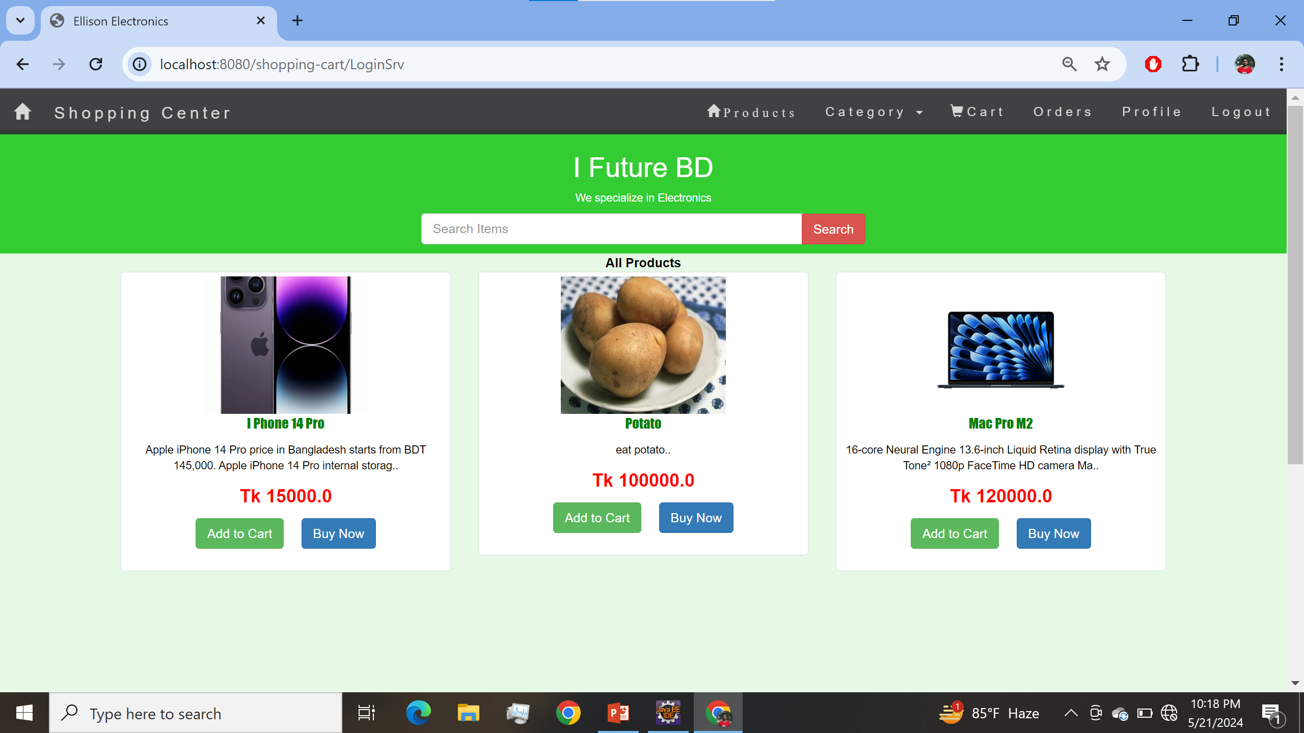
Class Name
ProductBean.java
ProductService.java
AddtoCart.java
OrderService.java
OrderServiceImpl.java
User Home Page

Slide 17
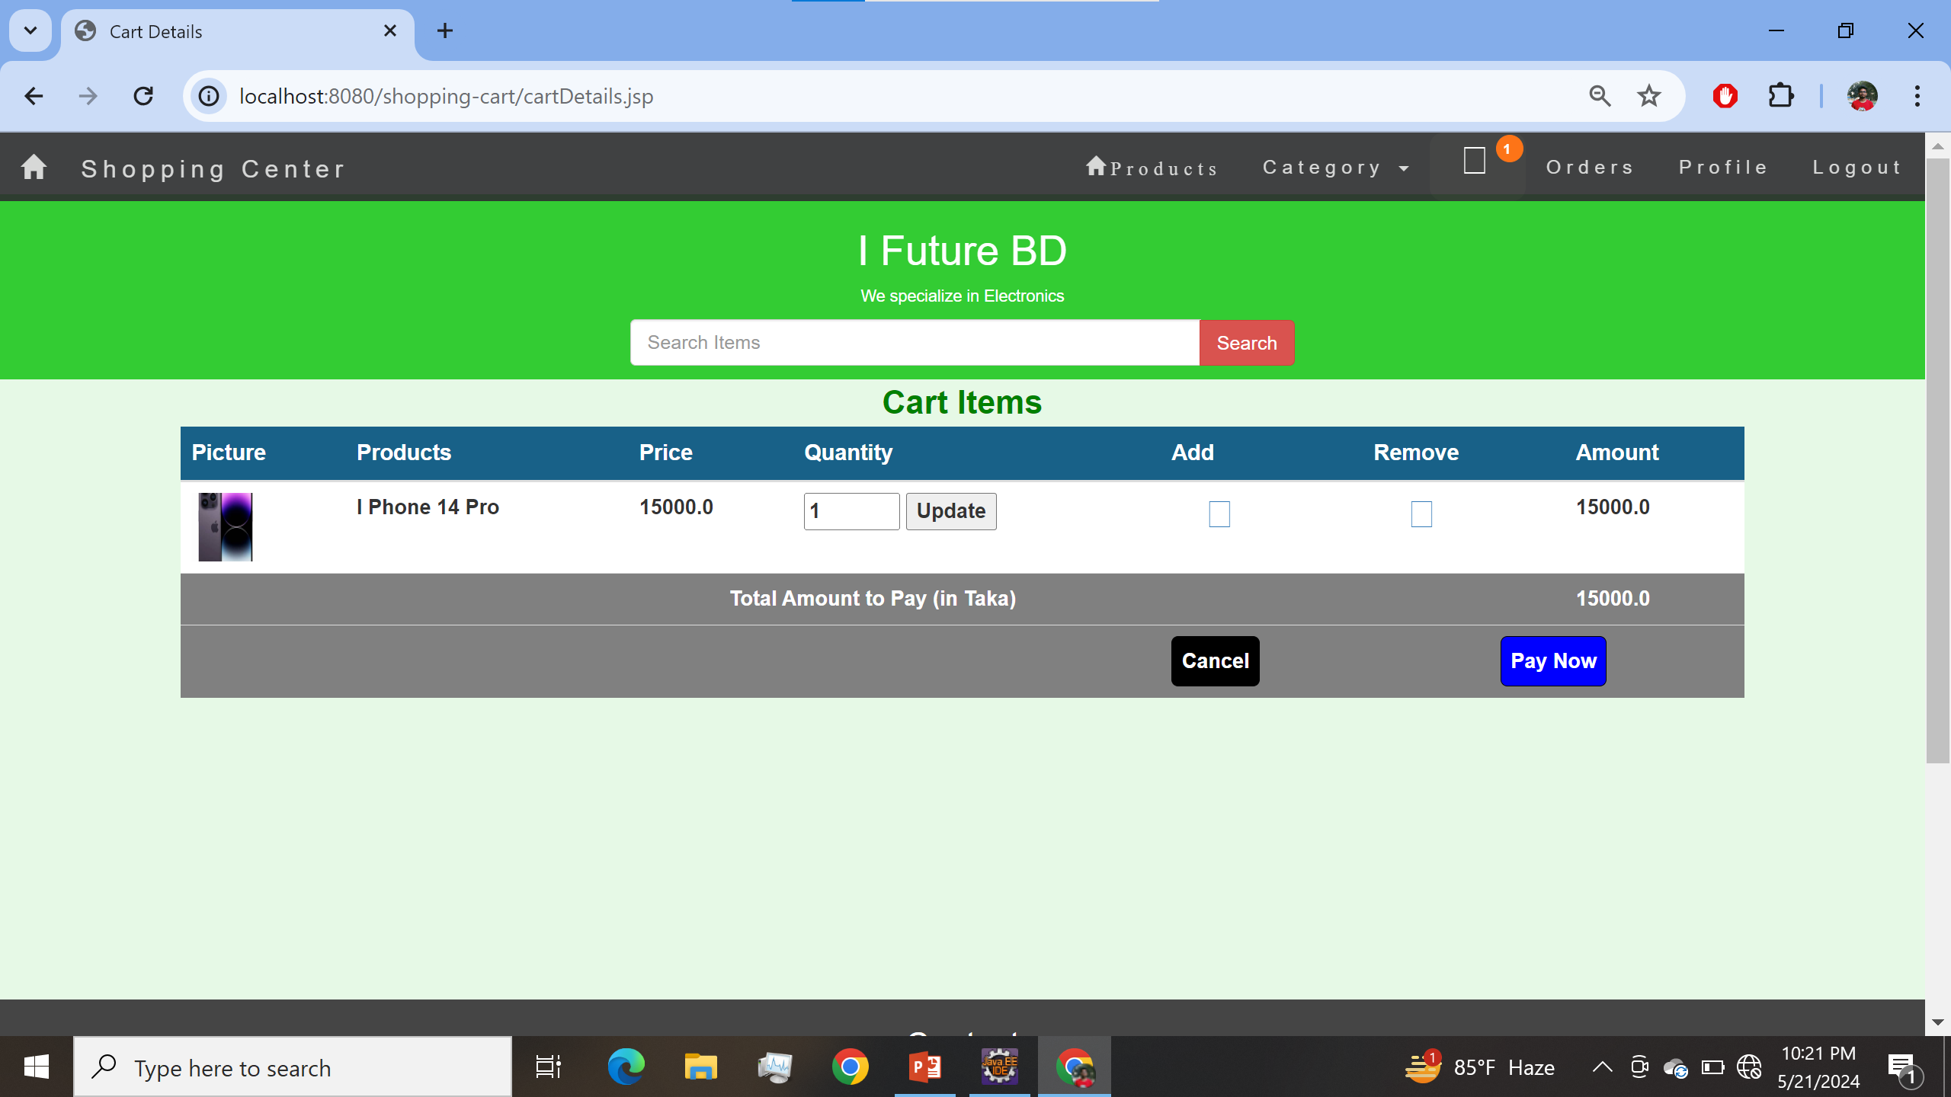
Class Name
AddtoCart.java
OrderService.java
OrderServiceImpl.java
UpdateToCart.java
Cart Page

Slide 18
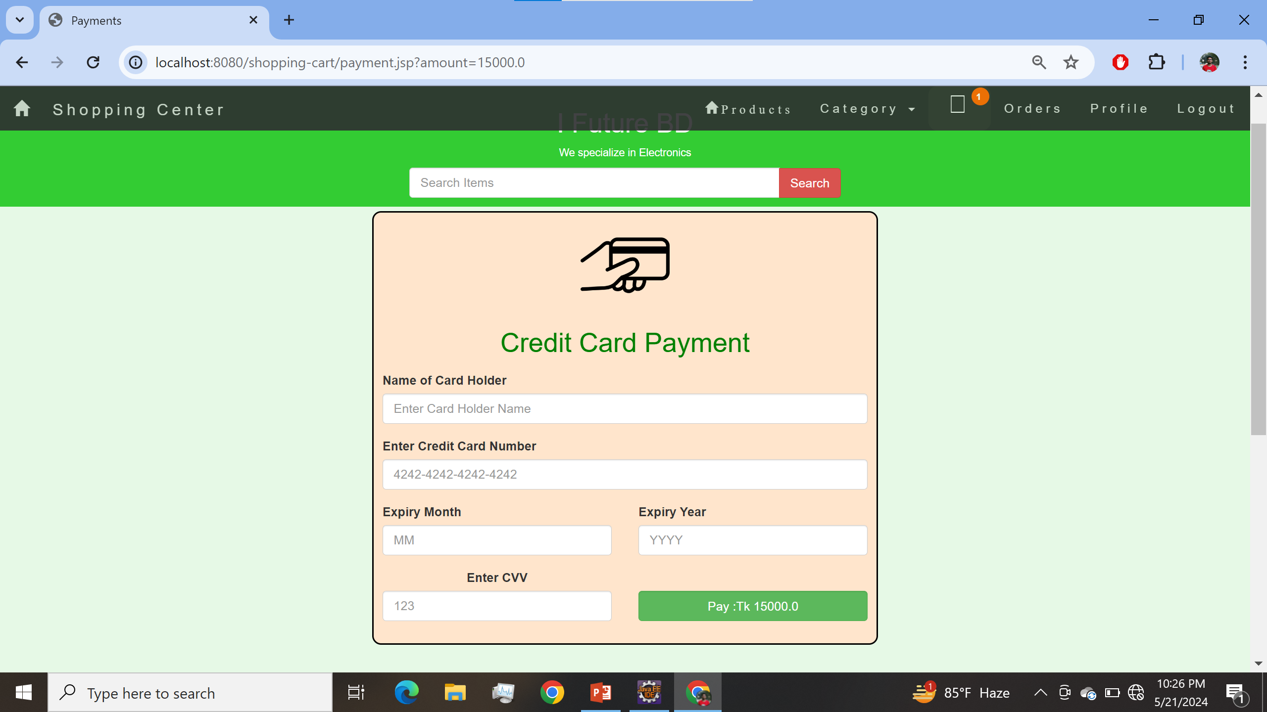
Class Name
TransactionBean.java
TransService.java
TransServiceImpl.java
JavaMailUtil.java
MailMessage.java
Transaction Page

Slide 19
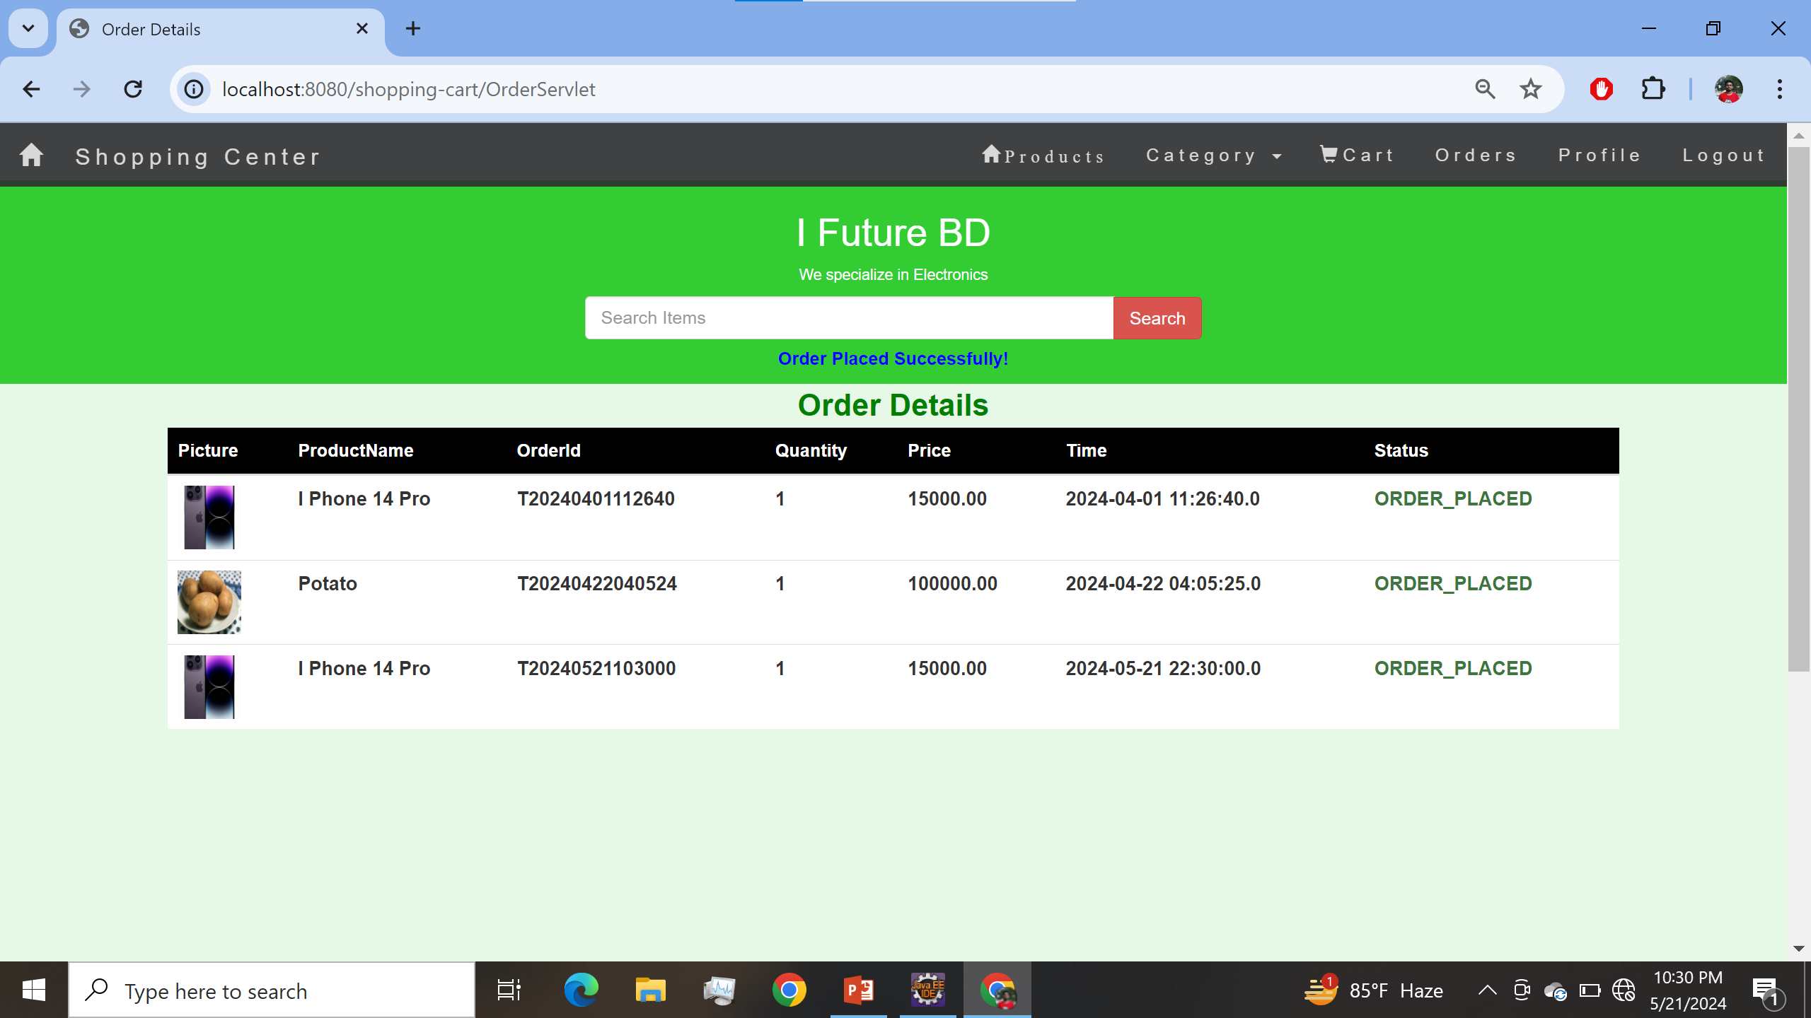
Class Name
OrderDetails.java
OrderService.java
OrderServiceImpl.java
OrderServlet.java
Order Details Page

Slide 20
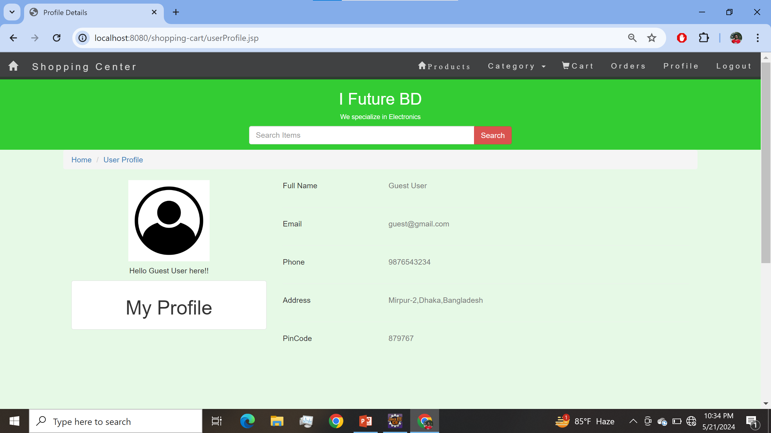
Class Name
UserBean.java
UserService.java
UserServiceImpl.java
User Profile Page

Slide 21
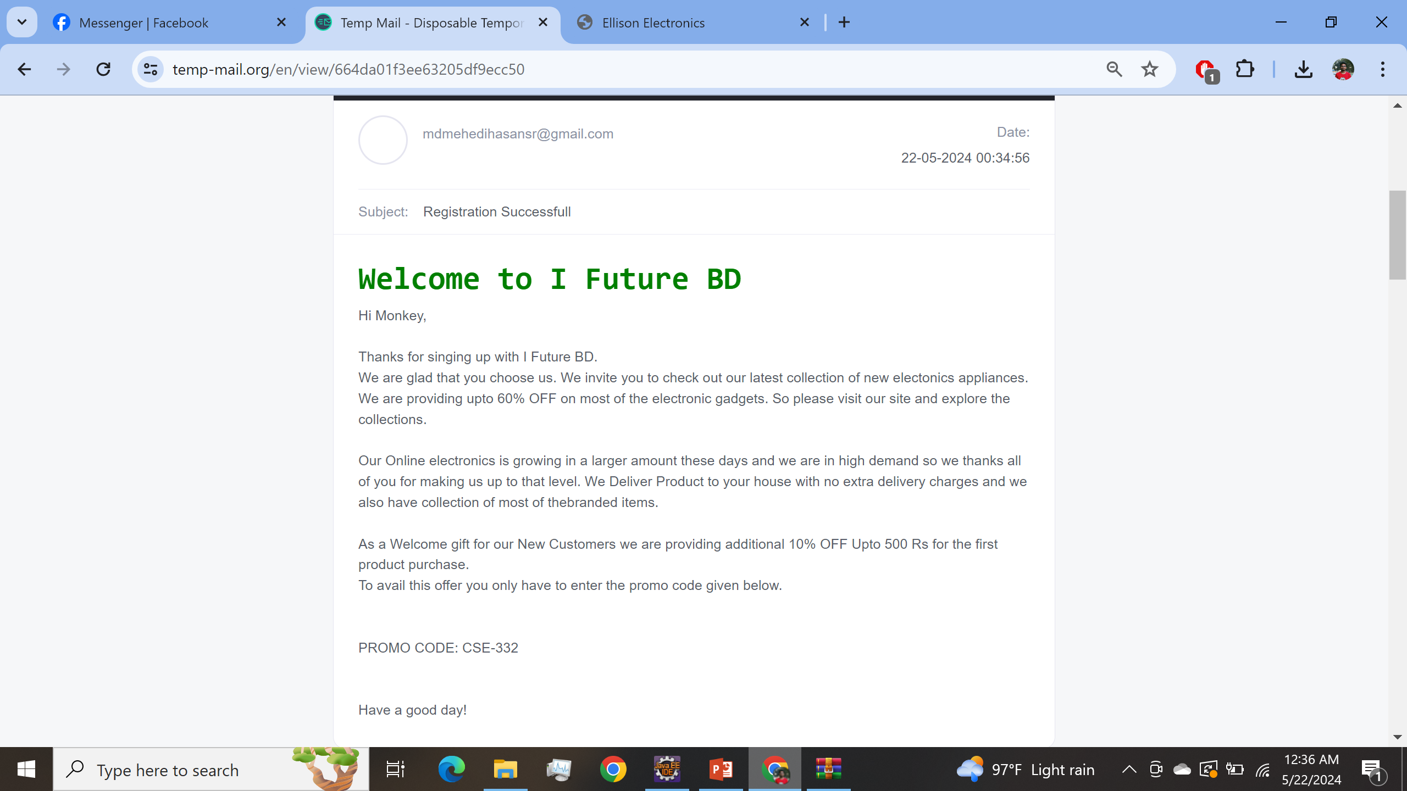
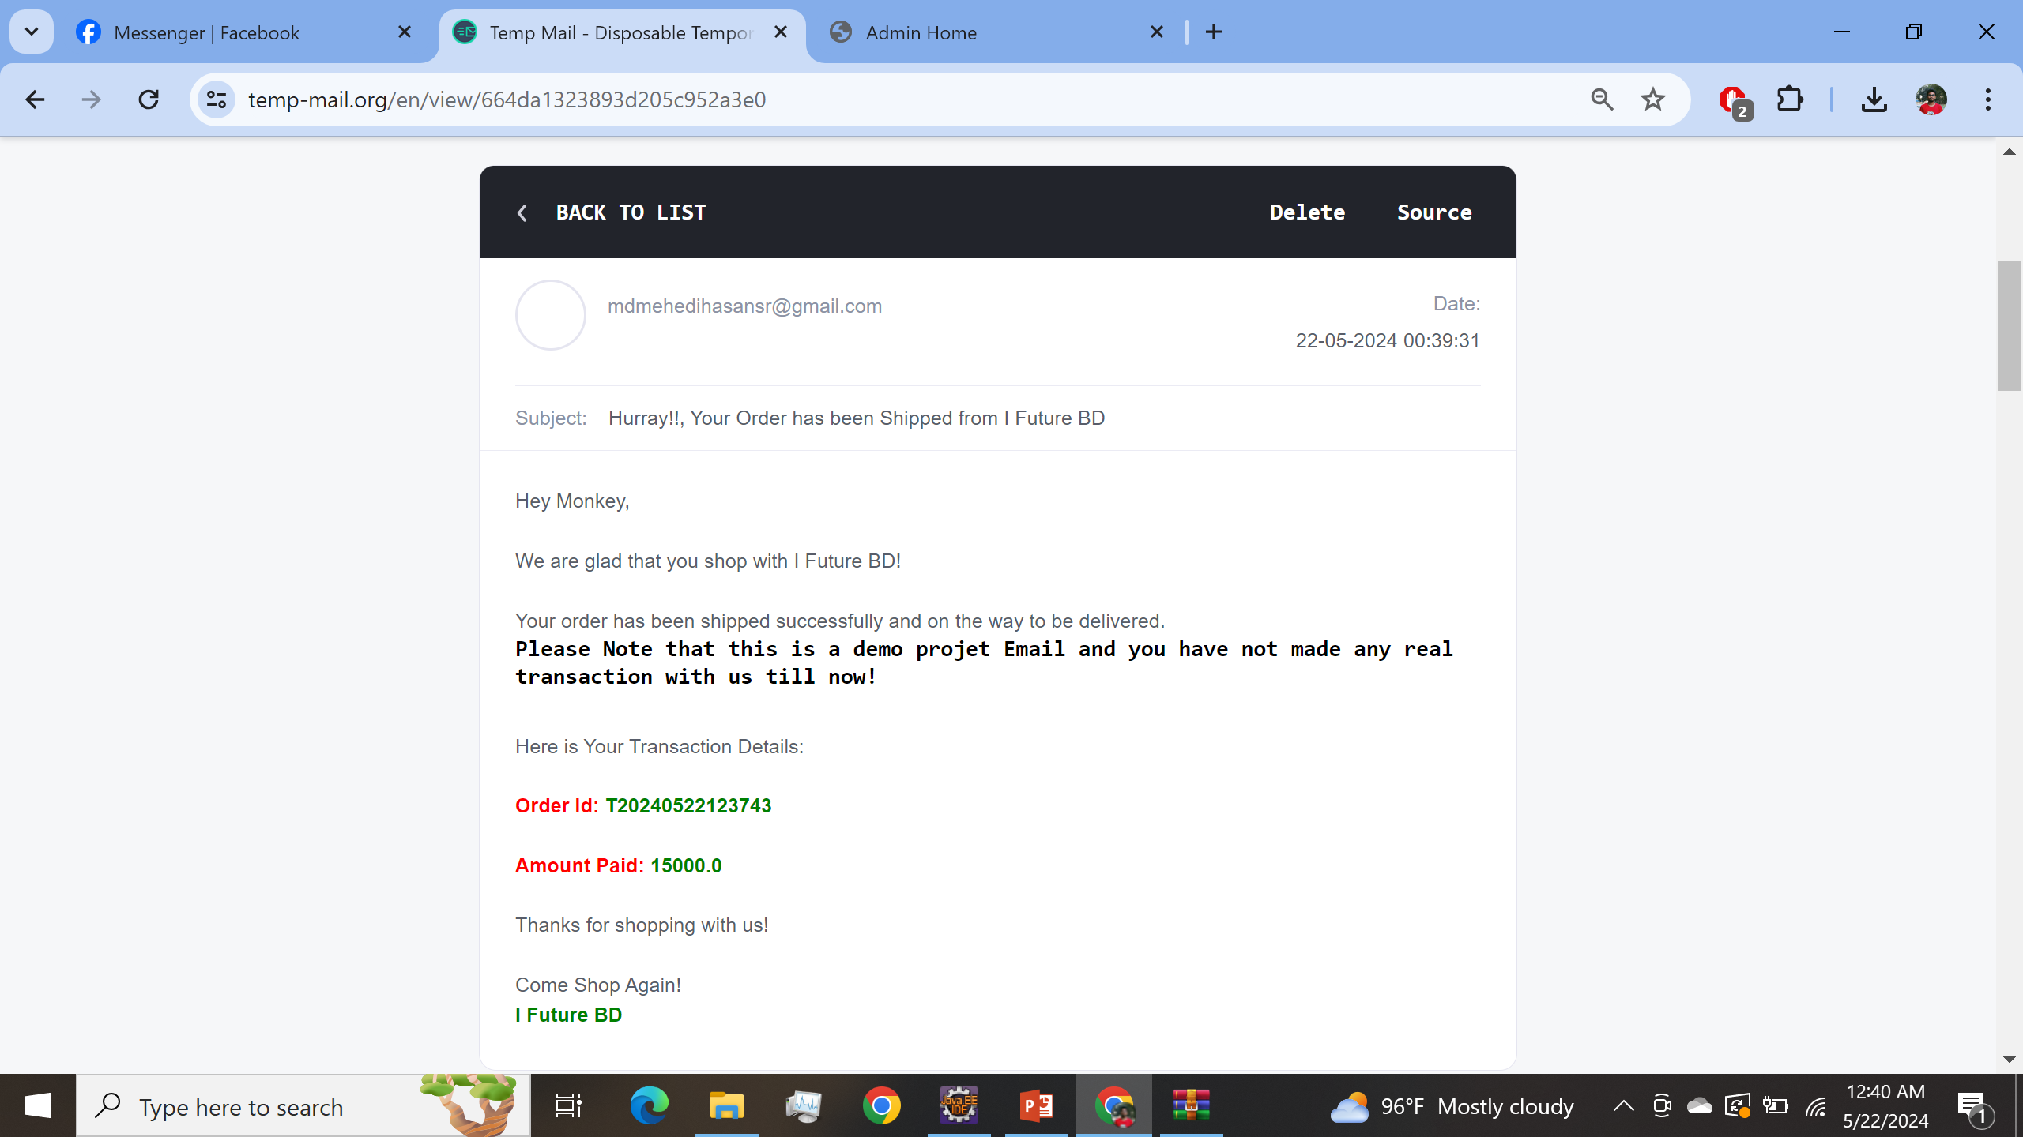
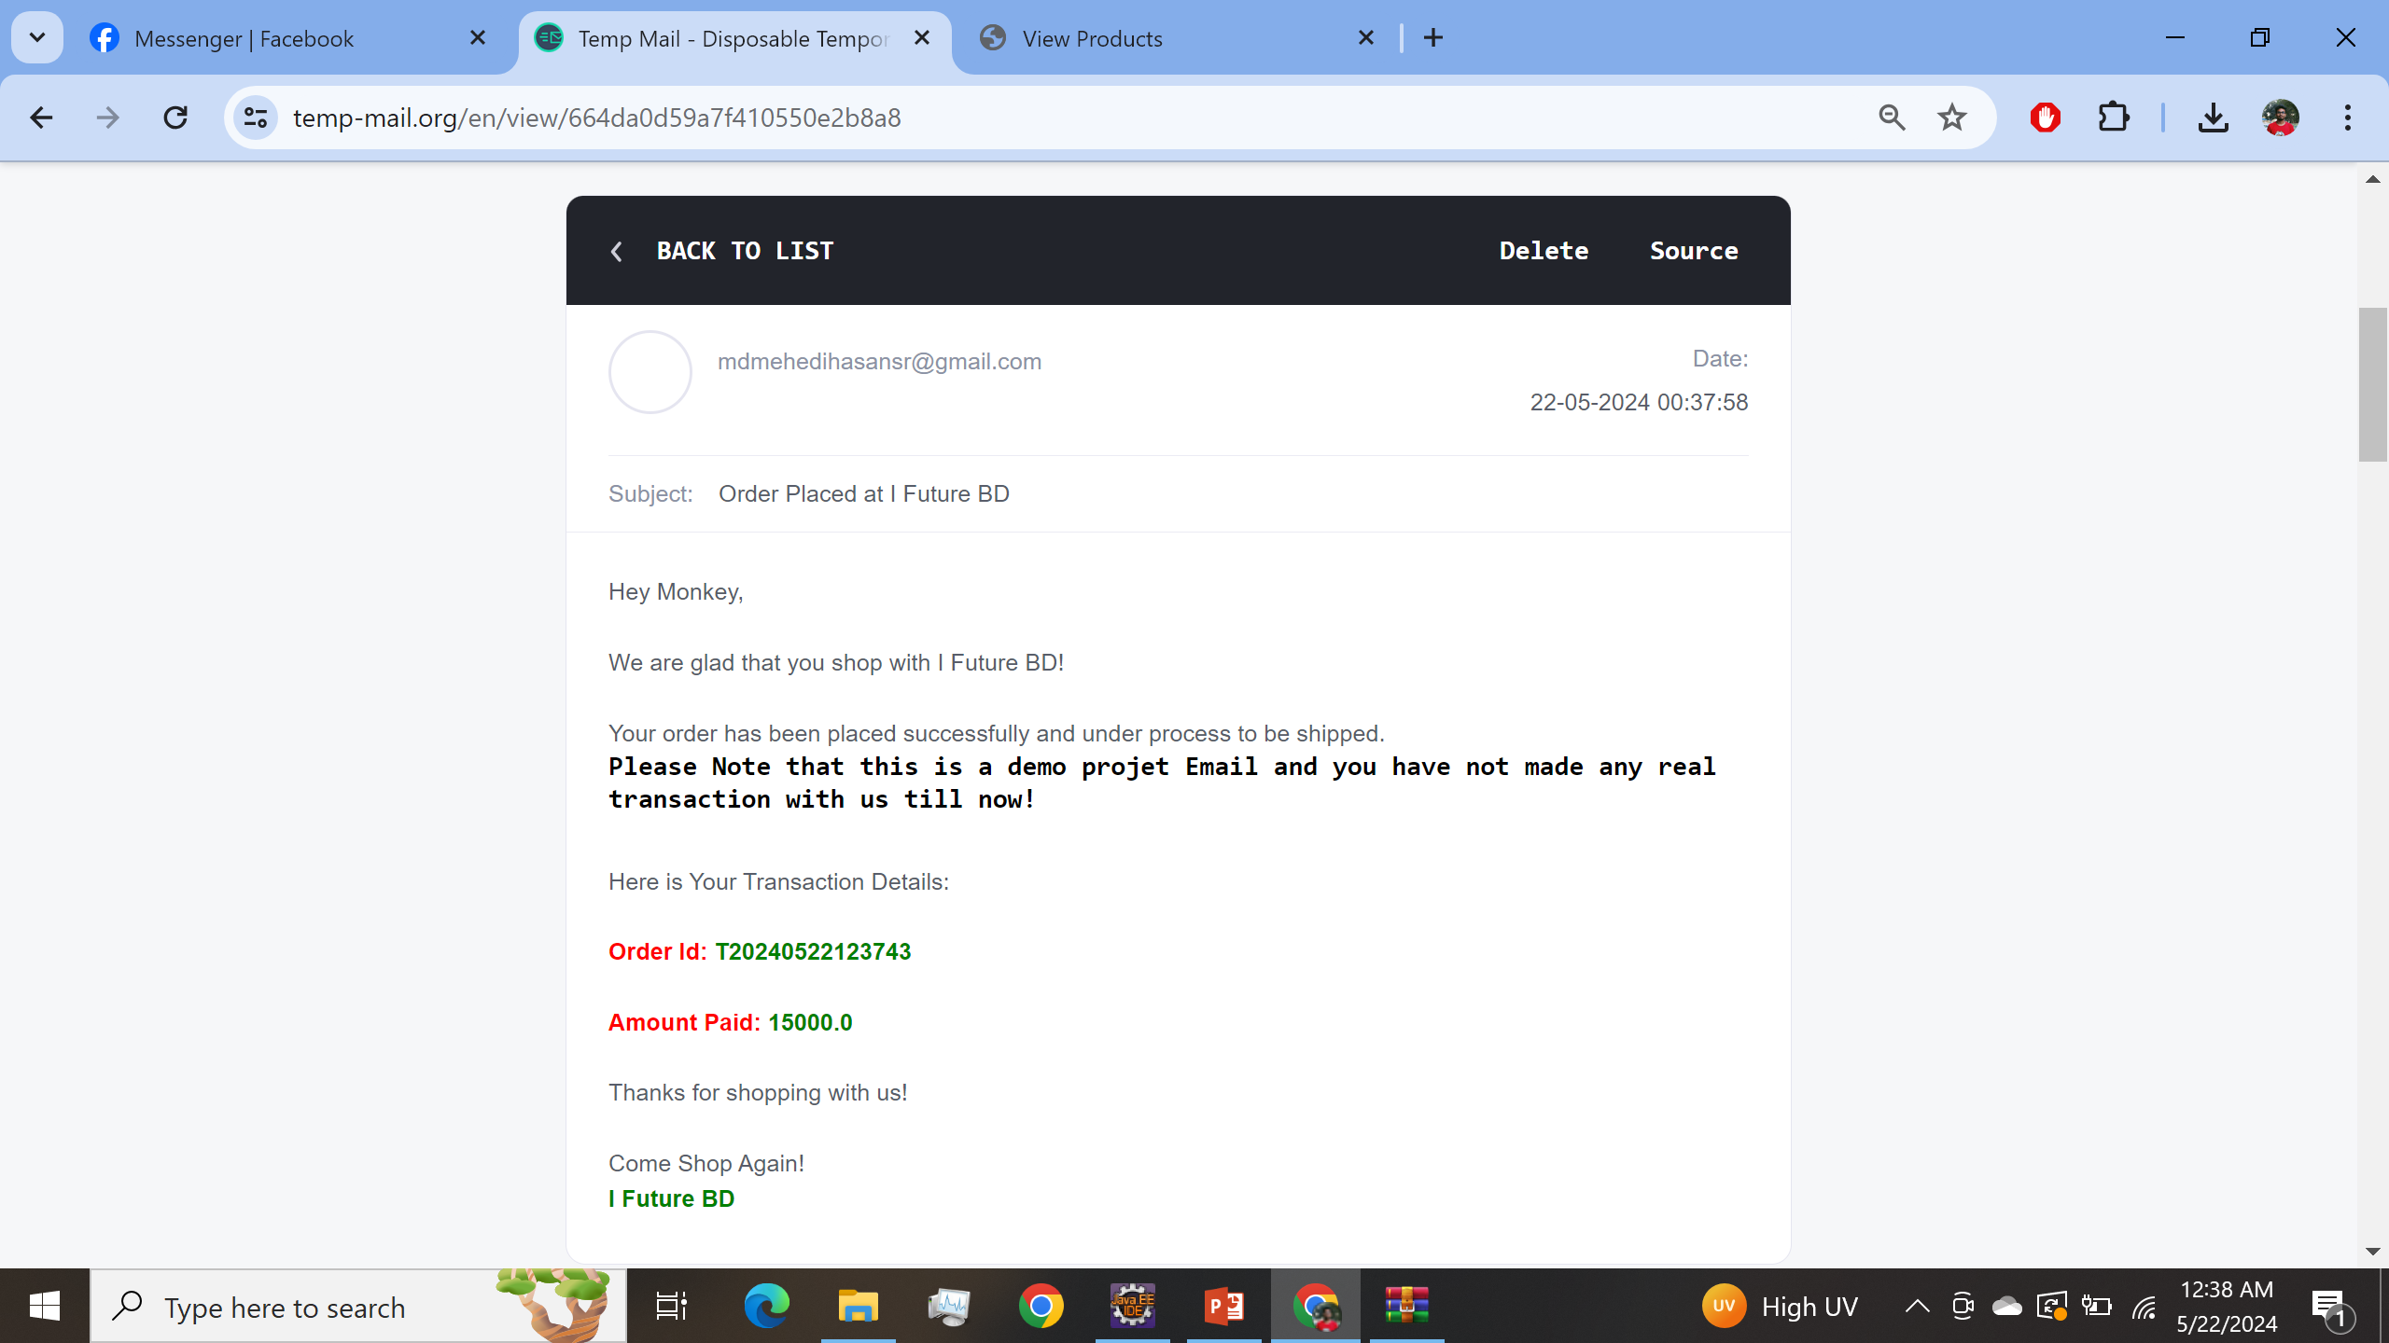
Class Name
JavaMailUtil.java
MailMessage.java

Slide 22


Slide 23


